Slide 1
Predicting solar storms
The extreme Bad Weather Day on earth
Wayne heller
April 2016

Slide 2
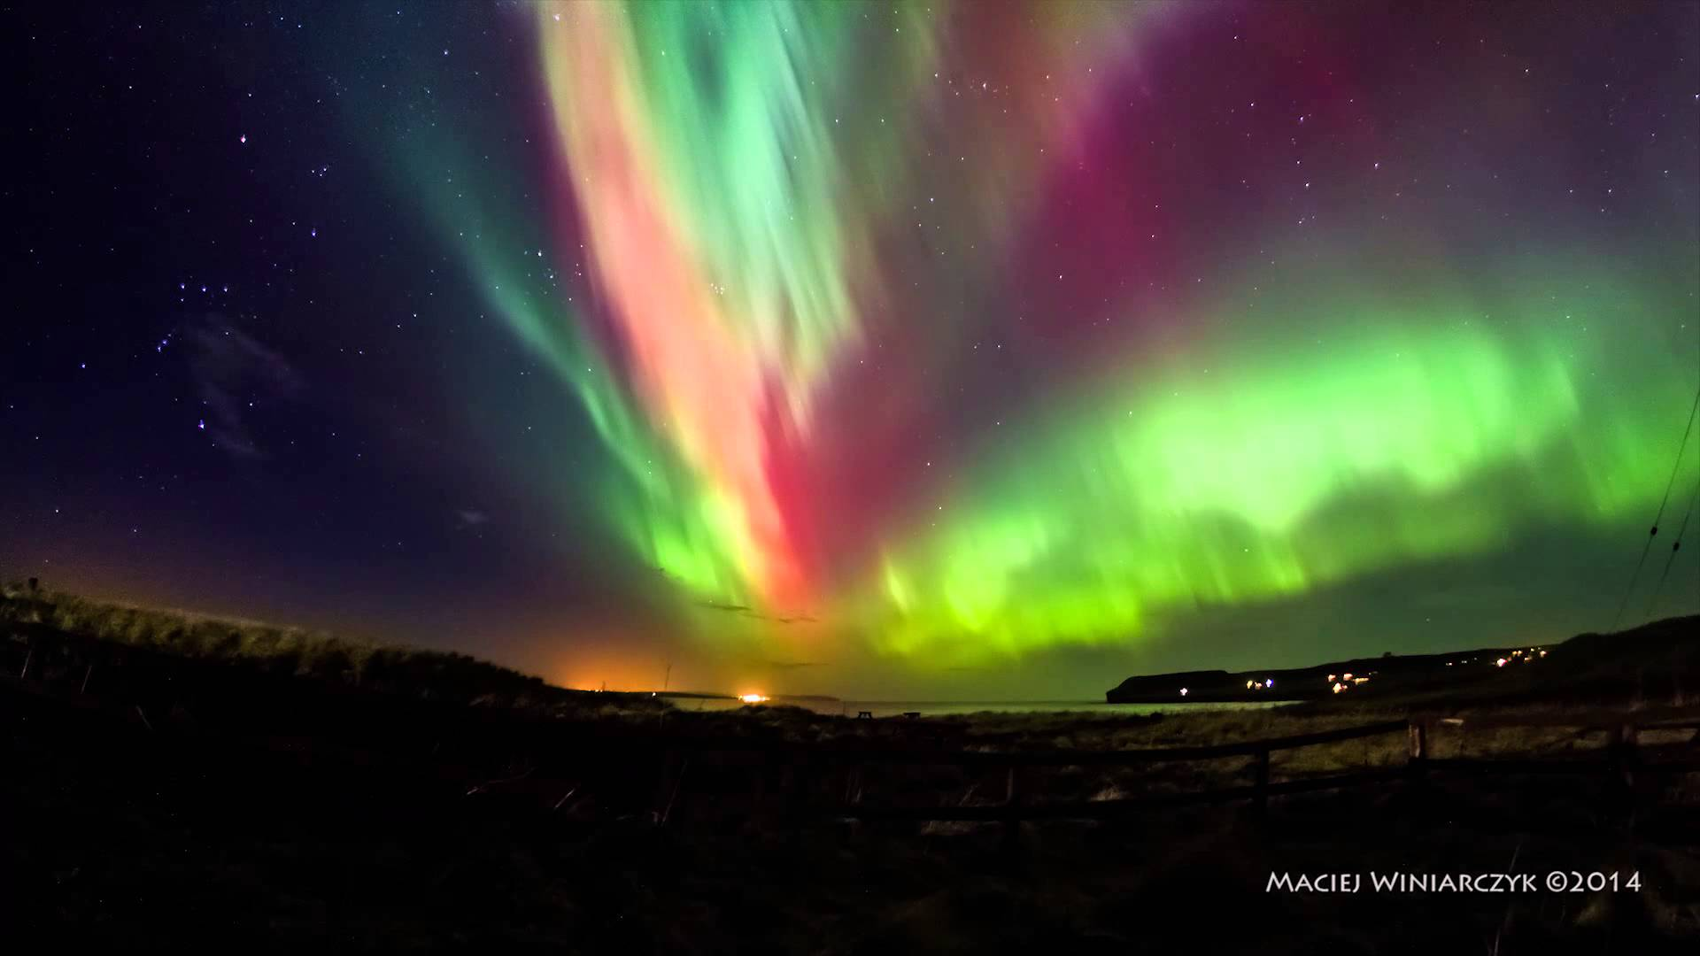
Beautiful, right? What is this?
The Northern Lights

Slide 3
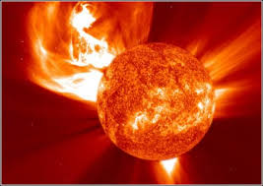
Solar storms
Release charged particles
Stream outward at 300 – 3000 km / sec
6 million miles / hour
Carrington Event 1859
$.2 – 2.6 trillion in damage
July 23, 2012 a Carrington Class event occurred
Notes:
The Solar Storm of 1859 — known as the Carrington Event — was a powerful geomagnetic solar storm hit Earth's magnetosphere and induced one of the largest geomagnetic storms on record.
Telegraph systems all over Europe and North America failed, in some cases giving telegraph operators electric shocks.[12] Telegraph pylons threw sparks.[13]
On September 1–2, 1859, one of the largest recorded geomagnetic storms (as recorded by ground-based magnetometers) occurred. Aurorae were seen around the world, those in the northern hemisphere as far south as the Caribbean; those over the Rocky Mountains in the U.S. were so bright that their glow awoke gold miners, who began preparing breakfast because they thought it was morning.[6] People in thenortheastern United States could read a newspaper by the aurora's light.[9] The aurora was visible as far from the poles as Sub-Saharan Africa (Senegal, Mauritania, perhaps Monrovia, Liberia), Monterrey and Tampico in Mexico, Queensland, Cuba, Hawaii,[10] and even at lower latitudes very close to the equator, such as in Colombia.[11]
In June 2013, a joint venture from researchers at Lloyd's of London and Atmospheric and Environmental Research (AER) in the United States used data from the Carrington Event to estimate the current cost of a similar event to the U.S. alone at $0.6–2.6 trillion.[2]
The March 1989 geomagnetic storm knocked out power across large sections of Quebec. On July 23, 2012 a "Carrington-class" Solar Superstorm (Solar flare,Coronal mass ejection, Solar EMP) was observed; its trajectory missed Earth in orbit.

Slide 4
What are the goals
Build a predictive model to estimate the geomagnetic activity on Earth in response to solar storms
Identify the factors on the Sun that result in high levels of geomagnetic activity on the Earth
Identify patterns on the Sun that can help predict Carrington-class Events.

Slide 5
The Data
Sources
The National Geomagnetic Data Center
NASA - Coronal Mass Ejection Catalog
Response
Several indices that record geomagnetic disturbance across the globe, aggregated and summarized
K indices isolate solar particle effects on the earth's magnetic field; over a 3-hour period
C9 - a qualitative estimate of overall level of magnetic activity for the day
Features
Sunspot activity
Coronal Mass Ejections attributes - Linear Speed, Acceleration, Mass, Energy

Slide 6
Data Exploration
NOAA data is clean, no missing values
SOHO - LASCO data is irregular, some it flagged as poor quality observations
Learning How To:
Working with fixed width file formats
Connecting disparate datasets
Handling the time series data where the correlated events are separated in time by irregular intervals

